Slide 1




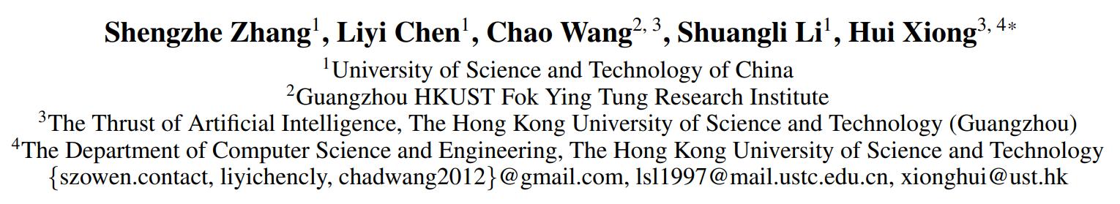



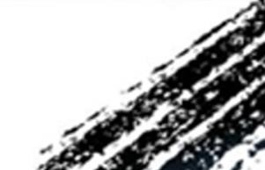

ATAI
Advanced Techniqueof Artificial Intelligence
ATAI
ChongqingUniversity _{AdvancedTechniqueof}
of Technology Artificial Intelligence
Chongqing University of
Technology
Chongqing University ^{ATAI}
_{of Technology} Advanced Techniqueof
Artificial Intelligence
Chongqing University of Technology
Chongqing University of Technology
  Temporal Graph Contrastive Learning for Sequential Recommendation
Code: None
2024.12.19•ChongQing
—— AAAI 2024
Reported by Shunan Yin
1

Slide 2

ATAI
AdvancedTechniqueof
Artificial Intelligence
ATAI
ChongqingUniversity _{AdvancedTechniqueof}
of Technology Artificial Intelligence
ChongqingUniversity of Technology
Motivation
(i). The multifaceted nature of temporal data, whether expressed in absolute or relative terms, poses integration complexities. Hence, it’s difficult to appropriately and effectively exploit multi-type temporal information in sequential
Recommendations.
(ii). Diverse changes at which user interests evolve complicate the deciphering of global interest transition patterns. Learning global transition patterns of user interests is important and difficult.
(iii). Unpredictable and diverse user behaviors tend to introduce noisy information, requiring robust and accurate temporal integration in SR.

Slide 3

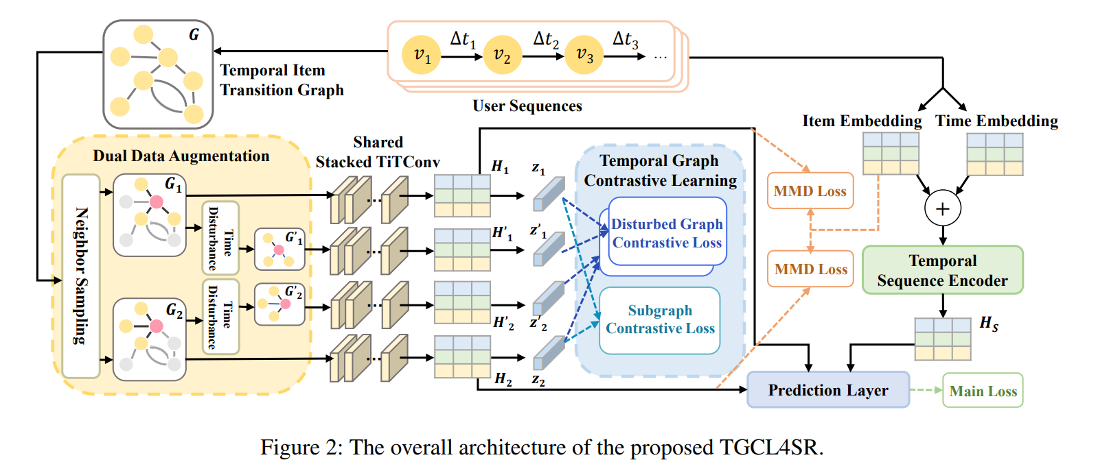
ChongqingUniversity of Technology
ATAI
AdvancedTechniqueof
Artificial Intelligence
ATAI
ChongqingUniversity _{AdvancedTechniqueof}
of Technology Artificial Intelligence
Overview

Slide 4
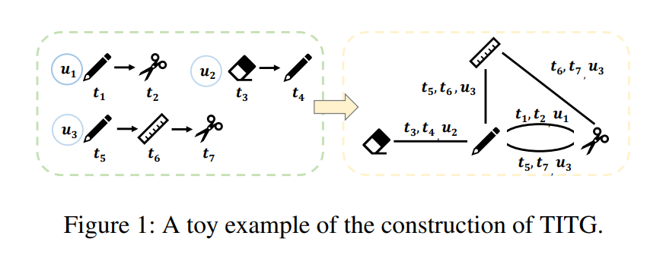
ChongqingUniversity of Technology
ATAI
AdvancedTechniqueof
Artificial Intelligence
ATAI
ChongqingUniversity _{AdvancedTechniqueof}
of Technology Artificial Intelligence
Overview

Slide 5



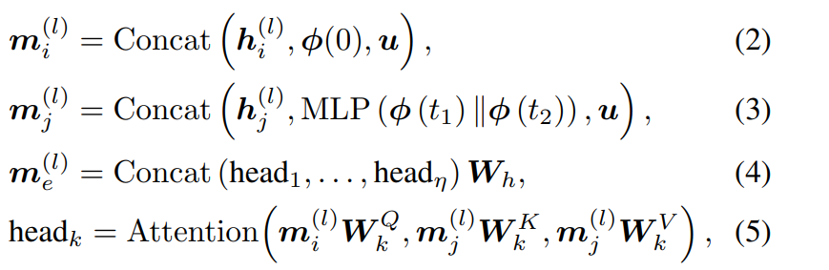
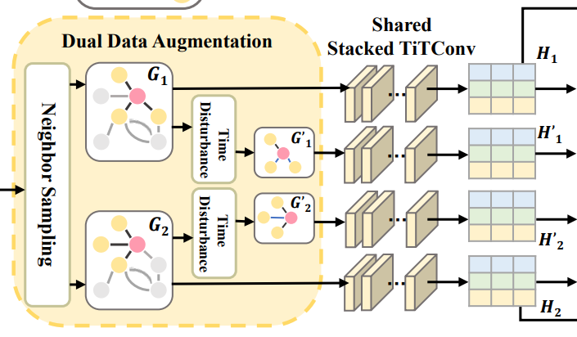
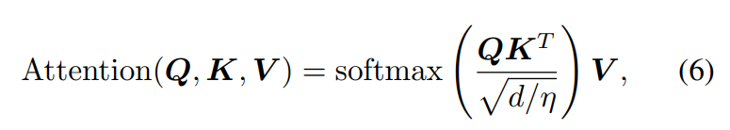
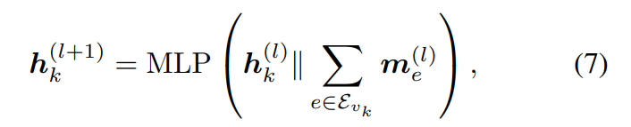
ChongqingUniversity of Technology
ATAI
AdvancedTechniqueof
Artificial Intelligence
ATAI
ChongqingUniversity _{AdvancedTechniqueof}
of Technology Artificial Intelligence
Method

Slide 6
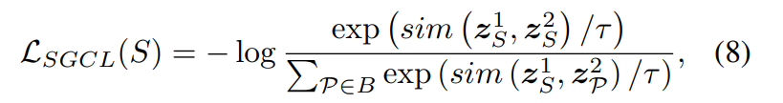
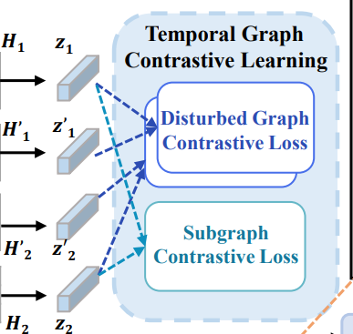
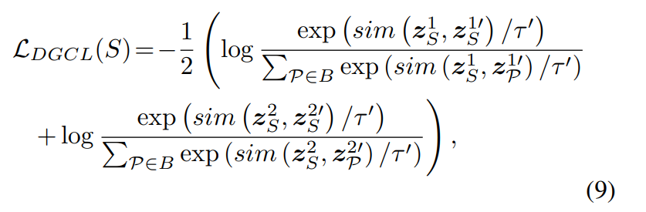
ChongqingUniversity of Technology
ATAI
AdvancedTechniqueof
Artificial Intelligence
ATAI
ChongqingUniversity _{AdvancedTechniqueof}
of Technology Artificial Intelligence
Method

Slide 7

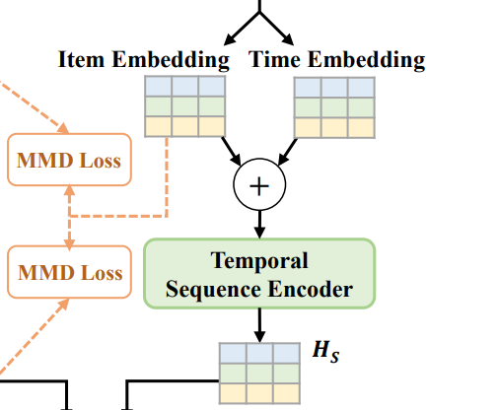


ChongqingUniversity of Technology
ATAI
AdvancedTechniqueof
Artificial Intelligence
ATAI
ChongqingUniversity _{AdvancedTechniqueof}
of Technology Artificial Intelligence
Method

Slide 8



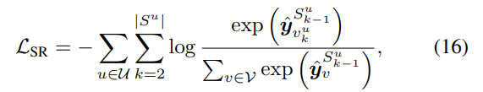

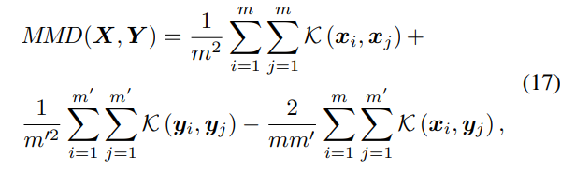
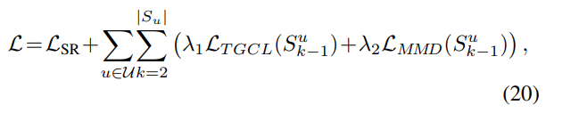
ChongqingUniversity of Technology
ATAI
AdvancedTechniqueof
Artificial Intelligence
ATAI
ChongqingUniversity _{AdvancedTechniqueof}
of Technology Artificial Intelligence
Method

Slide 9

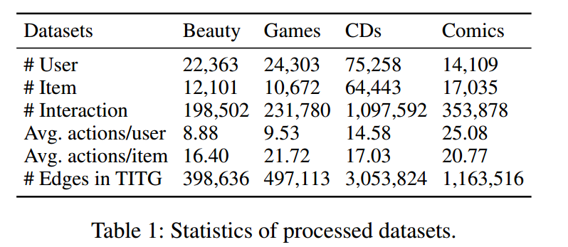
ATAI
AdvancedTechniqueof
Artificial Intelligence
ATAI
ChongqingUniversity _{AdvancedTechniqueof}
of Technology Artificial Intelligence
ChongqingUniversity of Technology
Experiments

Slide 10
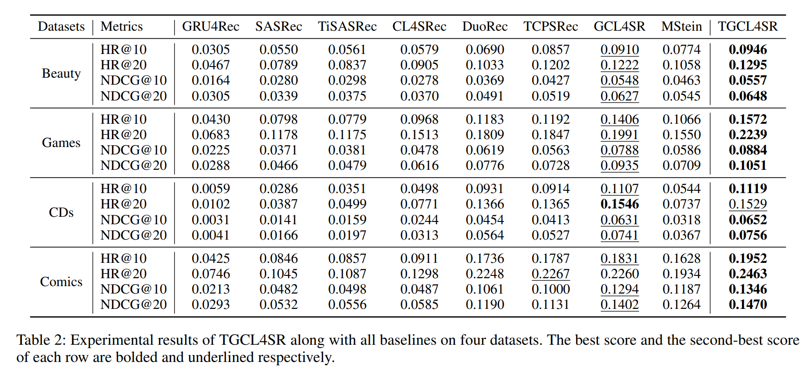
ATAI
AdvancedTechniqueof
Artificial Intelligence
ATAI
ChongqingUniversity _{AdvancedTechniqueof}
of Technology Artificial Intelligence
ChongqingUniversity of Technology
Experiments

Slide 11
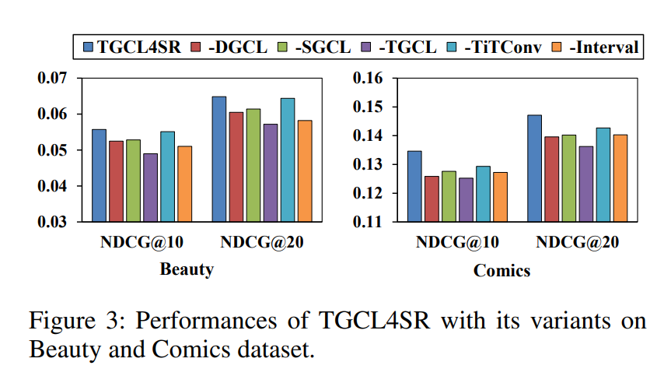
ATAI
AdvancedTechniqueof
Artificial Intelligence
ATAI
ChongqingUniversity _{AdvancedTechniqueof}
of Technology Artificial Intelligence
ChongqingUniversity of Technology
Experiments

Slide 12
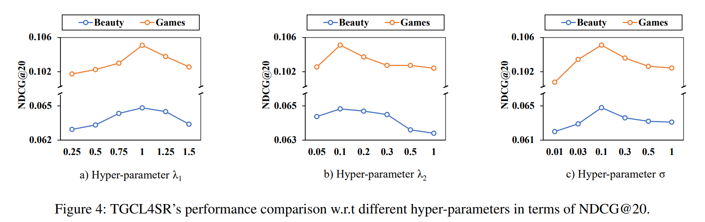
ATAI
AdvancedTechniqueof
Artificial Intelligence
ATAI
ChongqingUniversity _{AdvancedTechniqueof}
of Technology Artificial Intelligence
ChongqingUniversity of Technology
Experiments

Slide 13
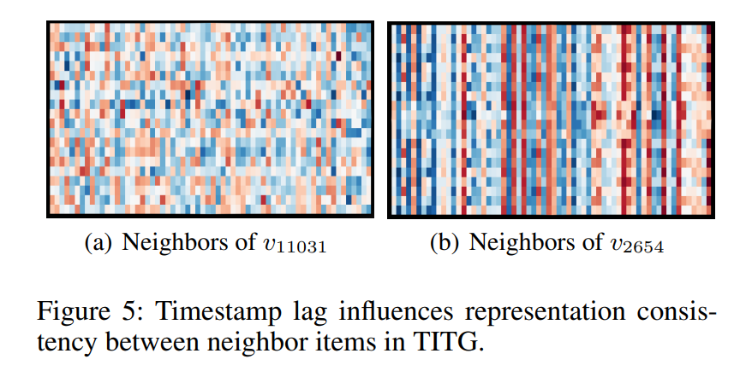
ATAI
AdvancedTechniqueof
Artificial Intelligence
ATAI
ChongqingUniversity _{AdvancedTechniqueof}
of Technology Artificial Intelligence
ChongqingUniversity of Technology
Experiments

Slide 14


ChongqingUniversity of Technology
ATAI
AdvancedTechniqueof
Artificial Intelligence
ATAI
ChongqingUniversity _{AdvancedTechniqueof}
of Technology Artificial Intelligence
Thanks!

